Slide 1
Hemispheres

Slide 2
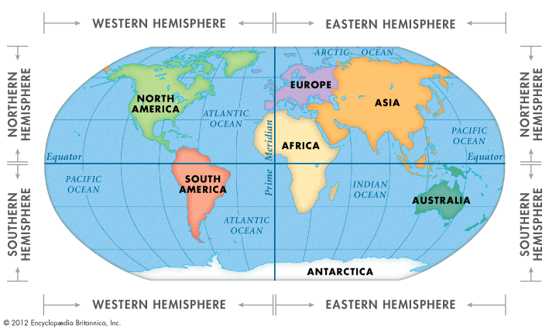
Hemispheres
The earth has four hemispheres:
Northern Hemisphere
Southern Hemisphere
Eastern Hemisphere
Western Hemisphere

Slide 3
Equator divides the earth into two hemispheres
The half north of the equator
is the Northern Hemisphere
The half south of the equator
is the Southern Hemisphere

Slide 4
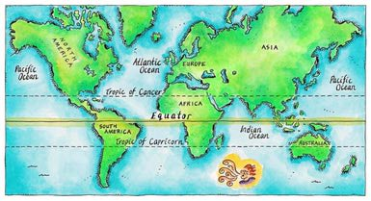
The Equator

Slide 5
Northern Hemisphere

Slide 6
Southern Hemisphere

Slide 7
Prime Meridian divides the earth into two hemispheres
Prime Meridian and the
International Date Line
The half east of the Prime
Meridian is the Eastern Hemisphere
The half west of the Prime
Meridian is the Western Hemisphere

Slide 8
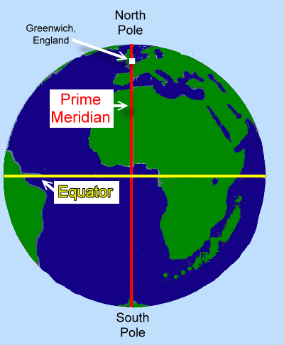
The Prime Meridian

Slide 9
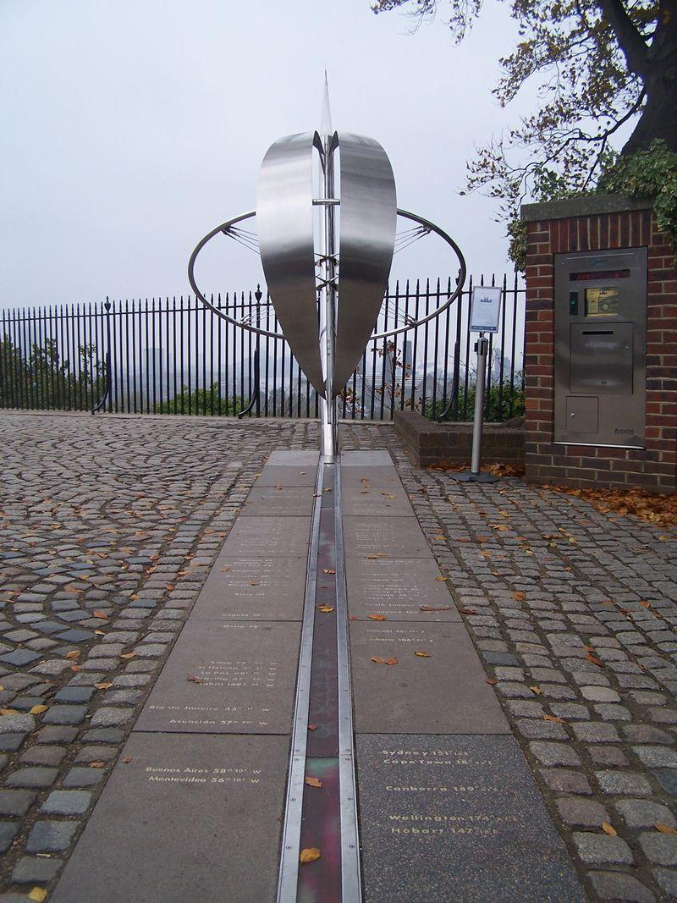
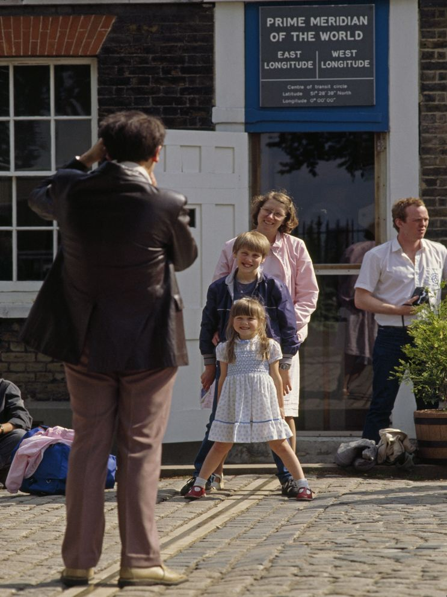
Greenwich, England

Slide 10
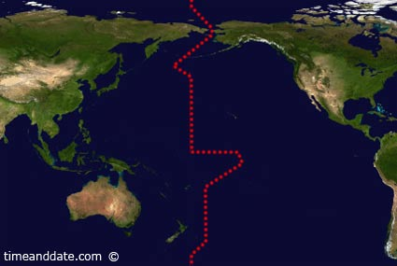
The International Date Line

Slide 11
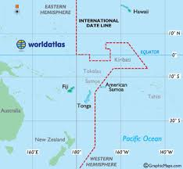
International Date Line up close

Slide 12
Eastern Hemisphere

Slide 13
Western Hemisphere

