Slide 1
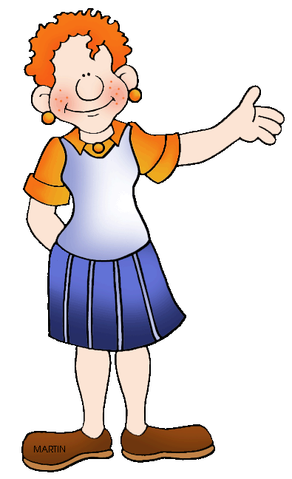
Written by Gary Martin
Illustrated by Phillip Martin

Slide 2
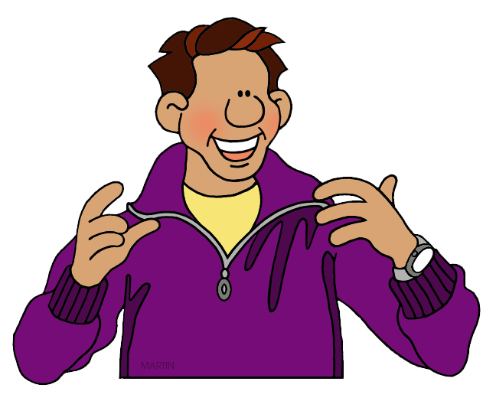
Proper nouns are the names of specific people, places and things. All proper nouns begin with a capital letter.
For example: Martin, Sears Tower, Ohio State University, New York City and Google.

Slide 3
Common nouns do not name specific people, places, things or ideas
For example: village, people, doctor, building, house, restaurant, desk, hospital and computer.

Slide 4
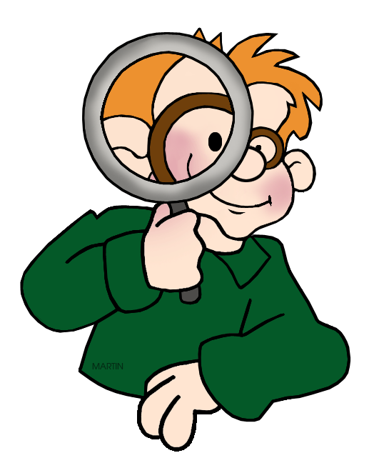
Can you find the common and proper nouns in the following sentences?

Slide 5
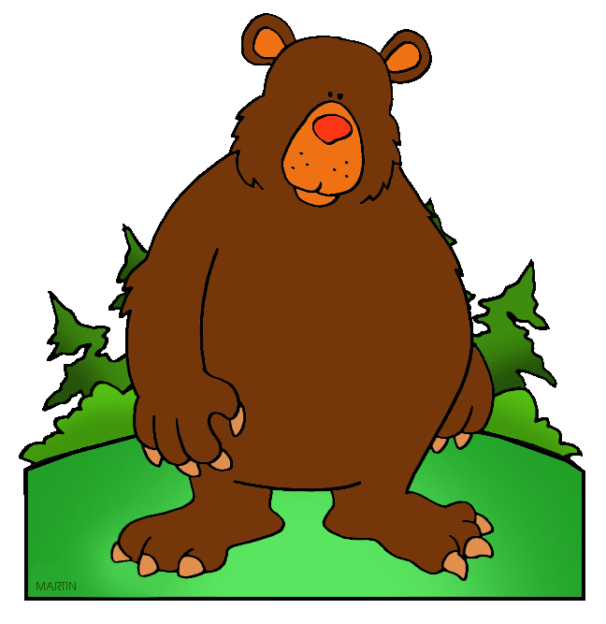
Barry Bear is king of all the bears in his neck of the woods.

Slide 6
Barry Bear is king of all the bears in his neck of the woods.
Since Barry Bear is a specific name, it is a proper noun.
King, in this case, is a common noun since it is not used specifically as part of a name. Bears, neck and woods are common nouns.

Slide 7
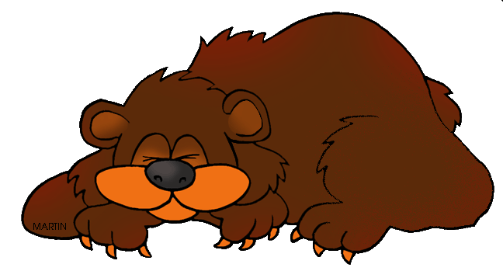
His kingdom is Katmai National Park in Alaska.

Slide 8
His kingdom is Katmai National Park in Alaska.
Kingdom is a common noun. Katmai National Park
is the name of a specific park so it is a proper noun.
Alaska is the name of a state so it is also a proper noun.

Slide 9
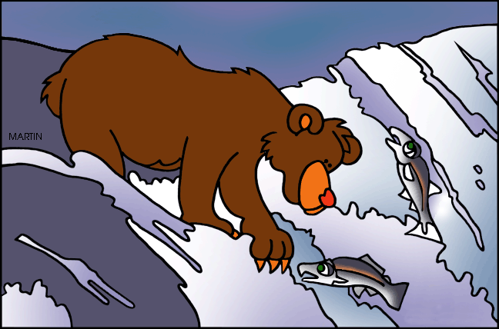
All the grizzly bears in his realm enjoy fishing for king salmon at Brooks Falls.

Slide 10
All the grizzly bears in his realm enjoy fishing for king salmon at Brooks Falls.
Since grizzly bears and king salmon are not the names of specific bears and fish, they are
common nouns.
However, Brooks Falls is the name of a specific place. It is a proper noun.

Slide 11
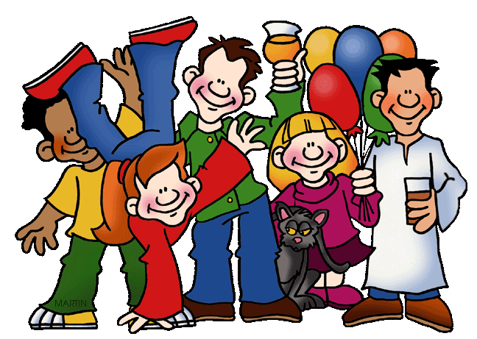
The news report said, King Barry Bear decreed, “All people entering my realm need to be caged and viewed as zoo animals.”

Slide 12
The news report said, King Barry Bear decreed, “All people entering my realm need to be caged and viewed as zoo animals.”
This time, since the title king is part of a specific name, it is a proper noun.
News report, people, realm and zoo animals
are common nouns.

Slide 13
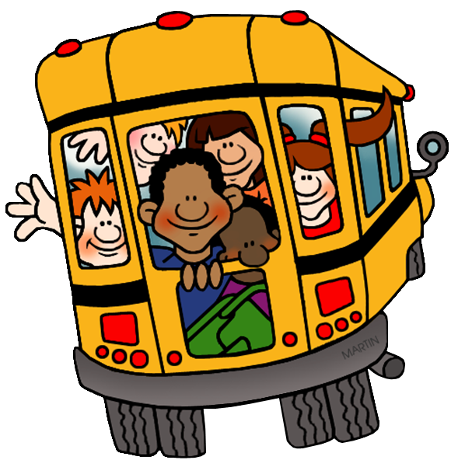
It’s a long field trip to Katmai National Park. After the bus trip, there are still two airplane connections.

Slide 14
It’s a long field trip to Katmai National Park. After the bus trip, there are still two airplane connections.
Katmai National Park
is a proper noun. All
The words in light
purple are common
nouns.

Slide 15
It’s a long field trip to Katmai National Park. After the bus trip, there are still two airplane connections.
The End

Slide 16
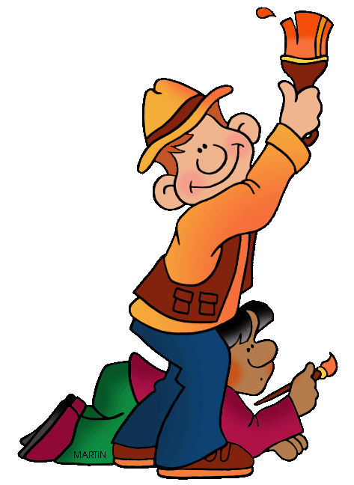
For more Presentations check out these links on phillipmartin.info and pppst.com. To find art for your own Presentations, check out Phillip Martin Clip Art.

