Slide 1
Revolutionary War Illustrations

Slide 2
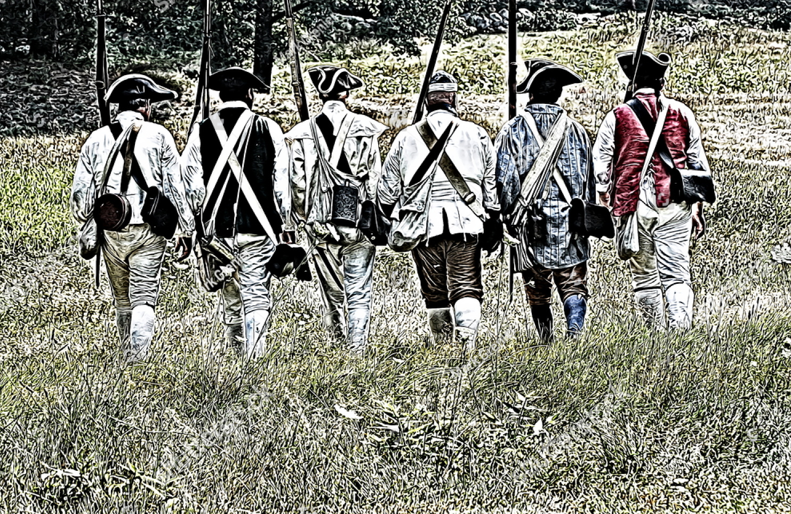
Patriots

Slide 3
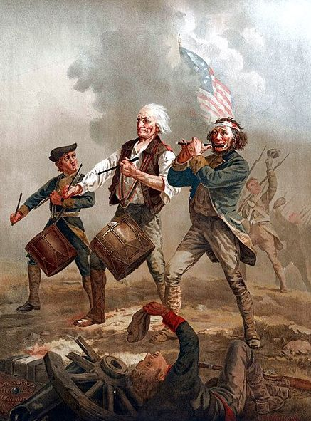
Spirit of ‘76

Slide 4
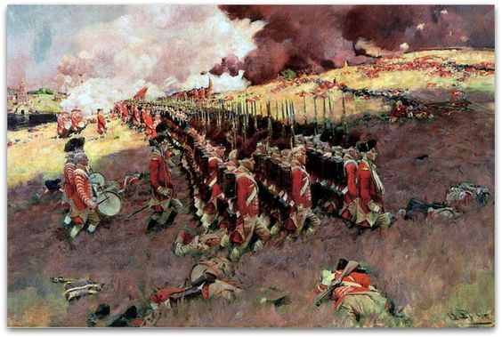
British Marching into Battle

Slide 5
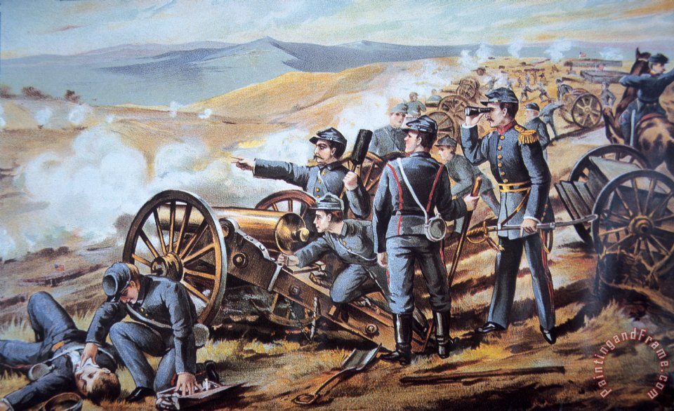
Battlefield

Slide 6
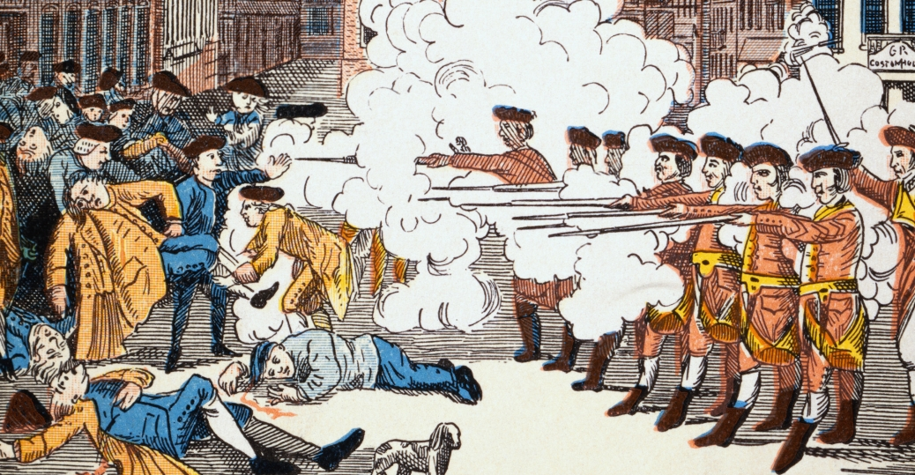
Boston Massacre

Slide 7
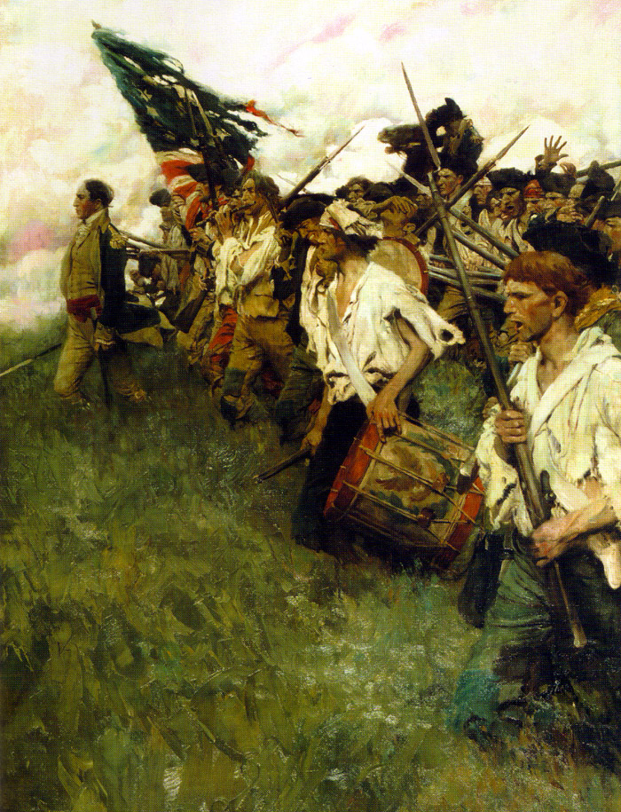
Heading Into Battle

Slide 8
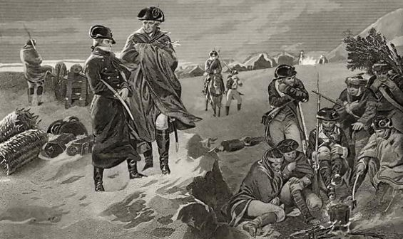
Valley Forge Winter

Slide 9
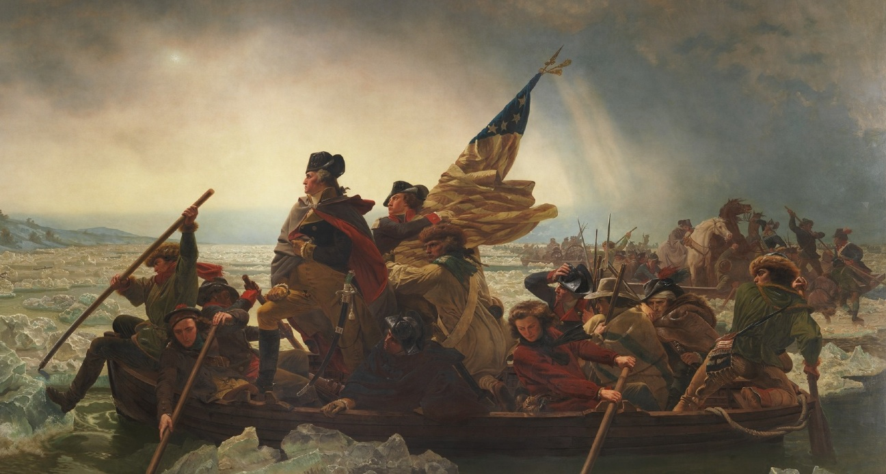
Washington Crossing the Delaware River #1

Slide 10
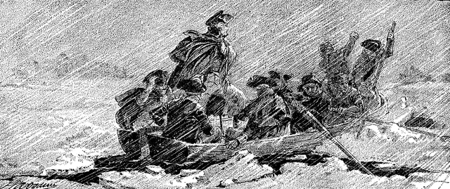
Washington Crossing the Delaware River #2

Slide 11
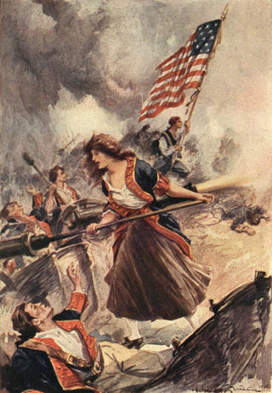
“Captain Molly” Corbin

