Slide 1
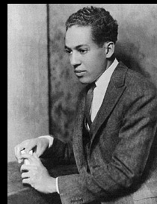
Thank You, M’am
By Langston Hughes

Slide 2
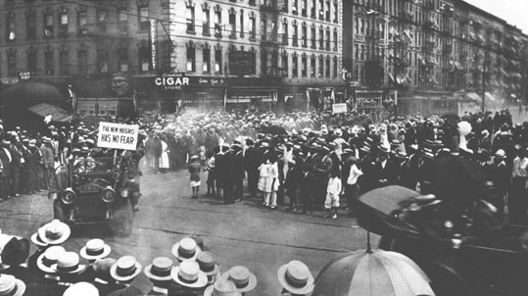
Harlem, New York
New York City, 1990s
Harlem
Neighborhood in New York City, 1920s

Slide 3
Kitchenette apartment

Slide 4
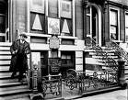
Vocabulary
Presentable:
respectable, fit to be seen, acceptable
Not dressed in blue jeans, tee shirt, dirty
“You might run that comb through your hair so you will look presentable.”

Slide 5
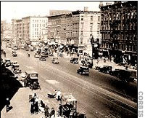
Mistrusted
distrust, doubt, suspect, be wary of, be afraid of
Crime scene in Harlem
And he did not want to be mistrusted now.
http://www.crimelibrary.com/graphics/photos/gangsters_outlaws/gang/harlem_gangs/1-1-Lenox-Avenue-in-Harlem-.jpg

Slide 6
Latching
Clutching. grasping. Holding, grabbing, seizing
…do not make the mistake of latching onto my pocketbook nor nobody else’s …

Slide 7
Barren
Unproductive, sterile, desolate, bleak, infertile, unfruitful, inhospitable
…he couldn’t even say that as he turned at the foot of the barren stoop and looked up at the large woman in the door.

Slide 8
Blue Suede Shoes

Slide 9
Characters
Roger
Main: conflict revolves around him
Both Internal and External Conflict
Dynamic: changes
Starts out a thief and liar
Wants Mrs. Jones to trust him at the end

Slide 10
Characters
Mrs. Luella Bates Washington Jones
Main: is involved in the conflict
Static: doesn’t change
Always caring and strong

Slide 11
Theme
Right vs. wrong
Just because you’re poor, doesn’t mean you should steal from others—Roger
Taking care of others that need to be cared for—Mrs. Luella Bates Washington Jones
Forgiveness
Restitution

Slide 12
Setting
Place
Harlem, New York
Dark walkway
Mrs. Jones’ small flat
One room: bedroom, kitchen, living room, bathroom
Time
Late at night
1950’s
Clues: Blue Suede shoes

Slide 13
Conflict
External
Man vs. Man
Roger steals Mrs. Jones’ purse
Internal
Man vs. Self
Roger wants to run away but doesn’t want to disappoint Mrs. Jones

